Slide 1
ML의 실용과 몇가지 팁 -learning rate, data preprocessing, overfitting, training / test data
+MNIST data

Slide 2
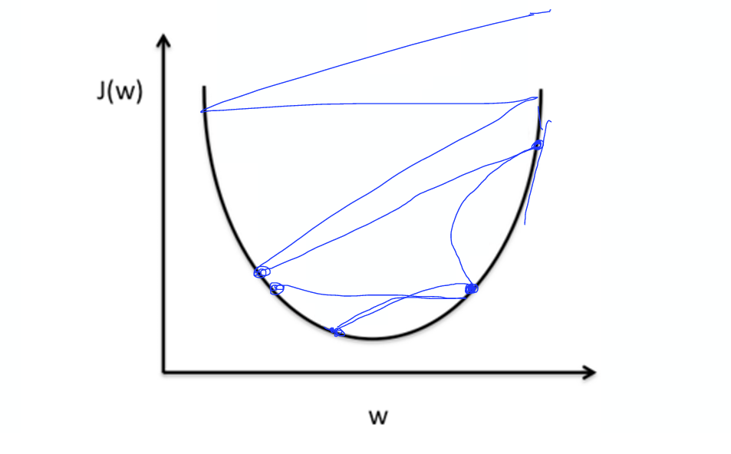
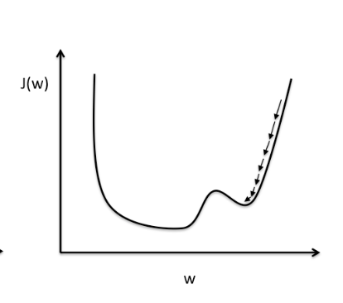
Learning late
Large learning rate
Small learning rate

Slide 3
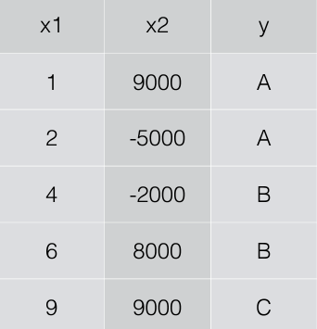
Data preprocessing
x1
Learning rate
값이 작더라도
Y_hat 값이
크게 변화할
수 있다!!!
x2

Slide 4
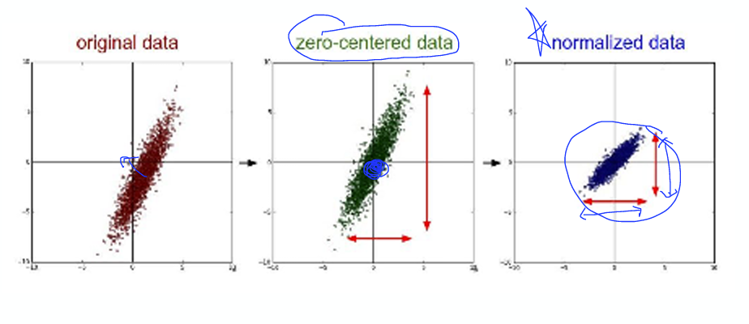
Data preprocessing

Slide 5
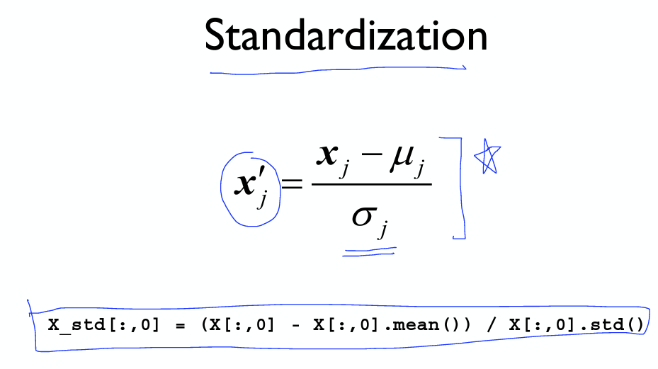
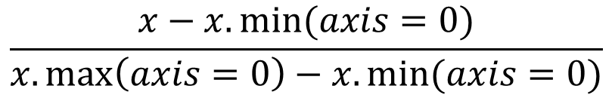
Data preprocessing
sklearn.preprocessing
MinMaxScaler(0~1)
평균
$$\frac{x−x.min⁡(axis=0)}{x.\max\left(axis=0\right)−x.min⁡(axis=0)}$$
분산

Slide 6
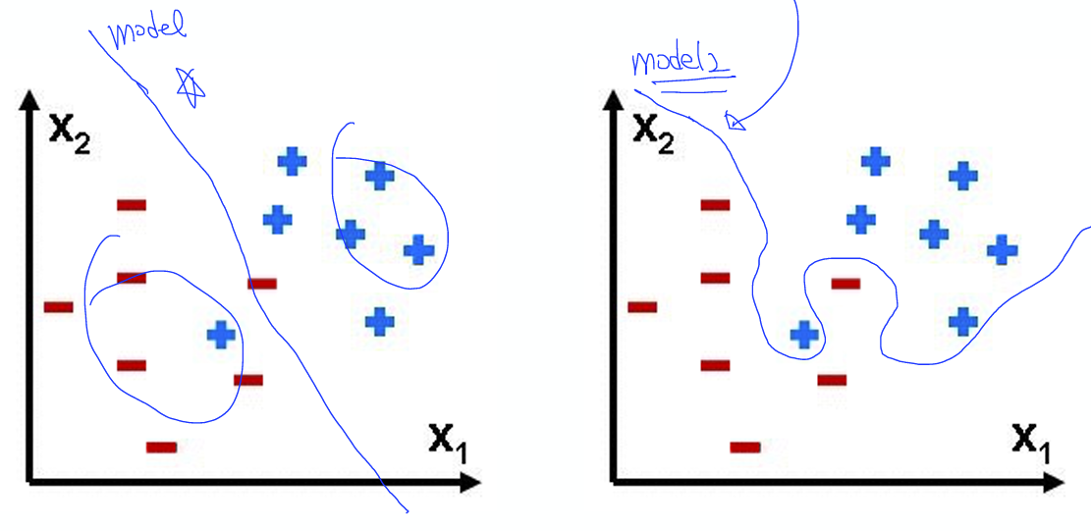
Overfitting
Which one is
better?

Slide 7
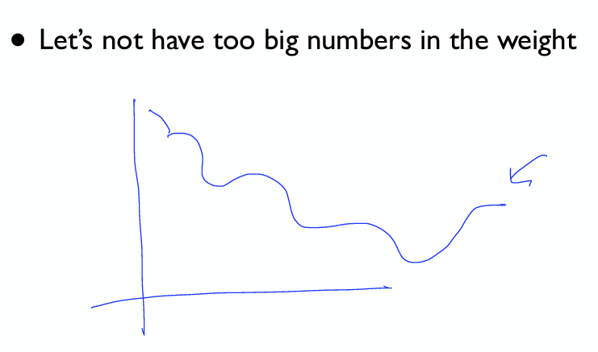
Overfitting
해결책은 training data를 늘리거나,
쓸모없는 features를 줄이거나…
Regularization!!!
Weight을 줄이는 것
Why large weights are indicative of overfitting?
A network with large network weights can be a sign of an unstable network where small changes in the input can lead to large changes in the output.

Slide 8
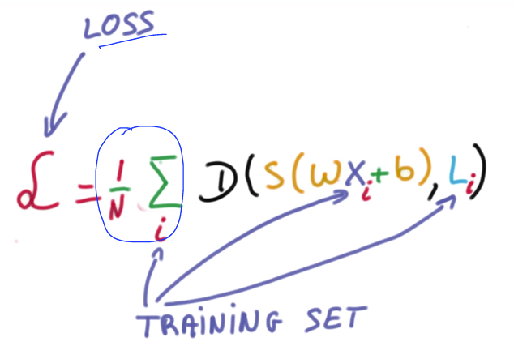
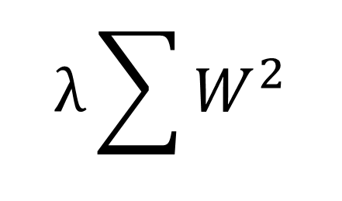
Overfitting
람다 상수
(정규화율)
$$λ\sum{W^{2}}$$
가중치 값이 커지면 cost함수도
커진다!

Slide 9
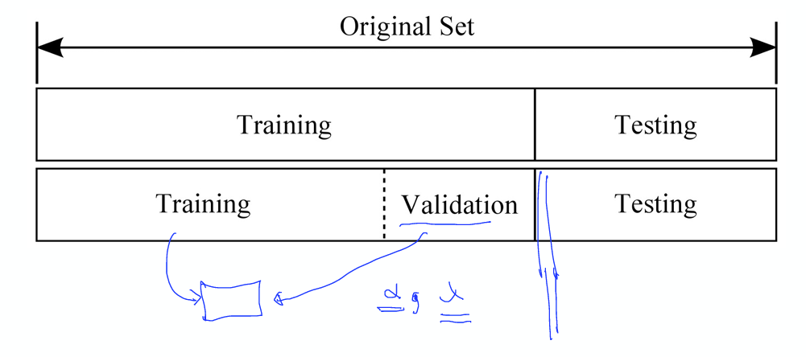
Training / test data set

Slide 10
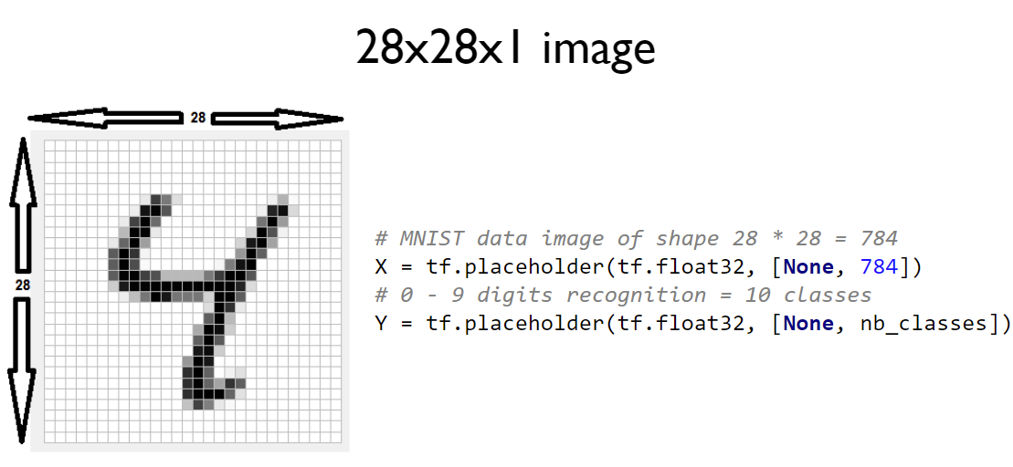
MNIST data

Slide 11
실습
Data preprocessing (Logistic_update.py)
Overfitting (IRIS_update.py)
MNIST data (MNIST_data.py)
(learning rate와 training / test data는 제외)

